Slide 1
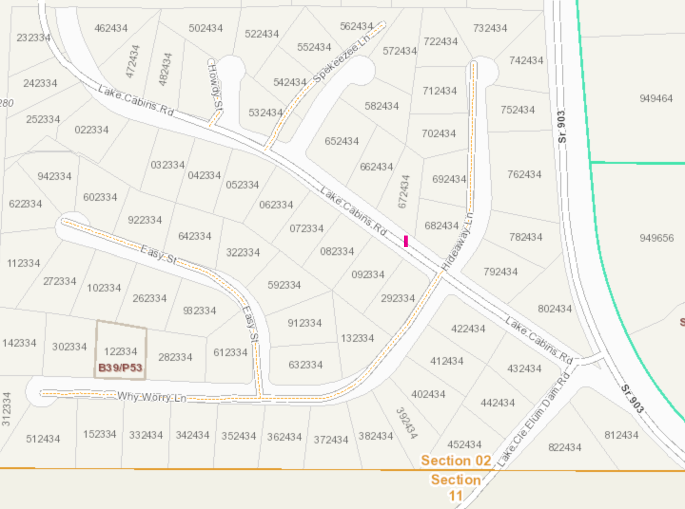
53– Allan & Gayla Barton
5 – Michael & Nancy Foley
16– Scott & Michelle Dibenedetto
1 – Phyllis Wenger
49 –Sue Morrison
1– Rory Kester & Zana Daudt
4– Tony & Betty Jovanovich
6
David Fitzpatrick
15 – Jay Chavis
50 –
Nick Coates
51 – Sam & Valerie Ward
17 – June Argyle
Wildwood II
2 – Kirk & Hollie Meiser
52 – Stephanie Eberle
3 – Delores Kester
14– Dawn Colston
7– James & Connie Kirk
Wildwood III
3 – Kirk & Hollie Meiser
2– George & Tiffany Brain
18 – June Argyle
4 – Warren & Jen Michelsen
13 –Ryan & Stephannie Joswich
8 – Chad & Sara Gresham
22 – Steve & Shannon Lessard
5 & 6 – Janice Reykdal
9 – Greg & Jennifer Mathews
12 –Scott & Julie Goodey
Lots 19 and 20– Gar Hill
7 – Kurt & Dawn Schonewald
8 – Lennon & Melissa Atteberry
10 – James & Carolyn Carpenter
23 – Robert & Claudia Shannon
21 – Jack and Kate Haugen
9 – Jeff Bainter
20 – Janice Reykdal
10 – Derek & Trudy Vaughan
11 – Protzeller & Cress
19 – Mark & Kimberly Fahey
21– Scott & Tawnya Beringer
24 – Robert & Claudia Shannon
18 – Mike & Kathryn Regeimbal
11 – Brad & Angelina Moore
25 – George & Kathleen Marshall
12 – Warren & Tammy Lance
22 – Gordon & Hillary Scholl
26 -John & Roxanne Smail
17 – Mike & Kathryn Regeimbal
27 – Bill & Becky Tracy
13 – David & Doreen Nicols
28 – Bill & Becky Tracy
16 – Mike & Kathryn Regeimbal
23– Scott & Lisa Ferguson
33 – Jessica & Ryan Moss
14 – Darice & Scott Casey
45 – Tim & Vonnie Penelerick
32 – Erik Seiffert & Piper Strand
29 – Wildwood Community “Lodge”
31 – Delana Coles
30 – Dan R. George
15 – Mike & Kathryn Regeimbal
44 – Kathie Brown
46 – Carole Smith
43 – Elizabeth Shea
47 Dale Torgerson
42 – Mike & Kathryn Regeimbal
35 – John & Kim Denning
36 – John & Kimberly Belcher
37 – Steve & Marcie Becher
38 – Steve & Marcie Becher
39 – Michael & Monika Richotte
40 – Christopher Kelderman
41 – Patti Sullivan
24 – Mike & Sandy Barker
34 – John & Kim Denning
48 – Bruce & Julie Salazar
25 – David Brauner

